Slide 1

Case study presentation MVP2 Group 13
By: Mihai, Jorn & Soufiane

Slide 2
Table of contents
Our Idea
URS
ECR
Cloud implementation
Load balancing & autoscaling
Our network
Demo
Struggles
Reflection
What’s next?

Slide 3

Our idea
Website for students and teachers
Uploading lectures and demos
Able to convert videos
In the cloud and on premises
Automation with terraform/ansible

Slide 4
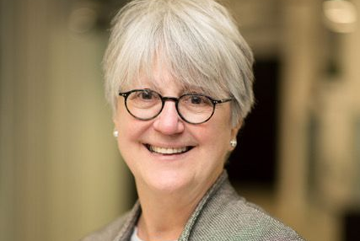
URS-Persona 1
Name: Morana
Wants:
A stable environment
A way to convert videos
A way to see watch logs
Notes:
Morana is a strict college teacher that always keeps an eye on every student.
Morana finds skipping lectures absolutley unacceptable and will let you know how she feels about it.
She usually never streams any lecture unless someone has a really good reason for why they cant be present physically.

Slide 5

URS-Persona 2
Name: Patrick
Wants:
A nice-looking environment
A way to convert files
Every student a personal account
Notes:
Patrick is a teacher at a university who cares a lot about his students.
He always tries makes sure that everyone knows and understands what he talks about during his lectures.
He has no issues with recording his lectures and demos for the students that cant physically come to school.

Slide 6

URS-Persona 3
Name: Yasmeen
Wants:
An organized environment
Filtering options
Notes:
Yasmeen is good university student who always tries to attend her lectures.
Yasmeen also has a job and works three evenings a week which means that she has to mis some lectures or some parts of the lectures.
Since Yasmeen has a job it would be nice to use the time she has for school efficiently.

Slide 7

ECR
To store, manage and deploy images
No upfront fees or commitments
Simplify your deployment

Slide 8

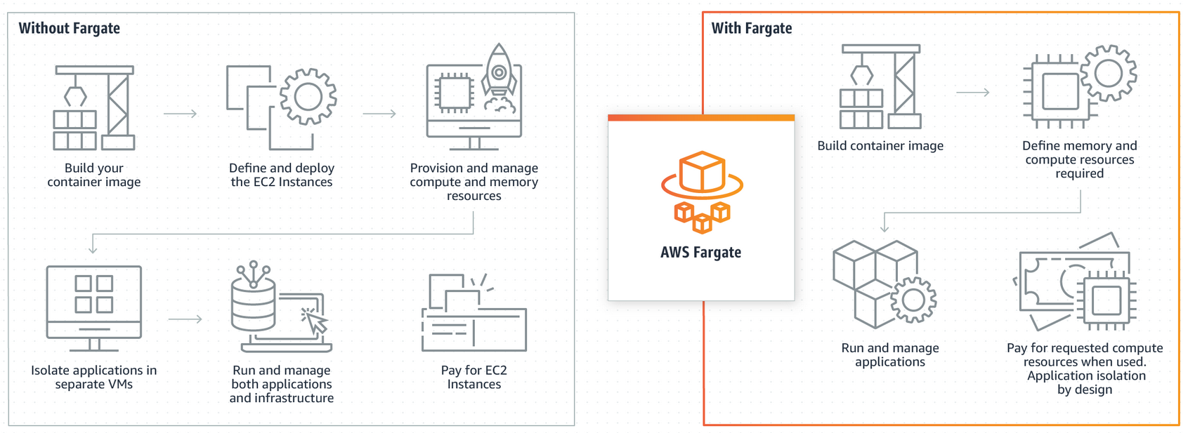
ECS Cloud implementation
Fargate
Easy serverless deployment and automation through Docker/ECR
pay per usage of hardware, instead of ec2 hourly
Notes:
Removes the need to manage servers, easy to manage cluster tasks( for example changing version of webapp)

Slide 9



Load balancing & autoscaling
Layer 7 Application load balancer
Supports both HTTP/HTTPS traffic balancing
Health checks in target groups
Multi Availability Zones
Automatically starts instances using CloudWatch alerts based on thresholds
Saves costs by keeping used instances running only
Ensures high availability and scalability

Slide 10
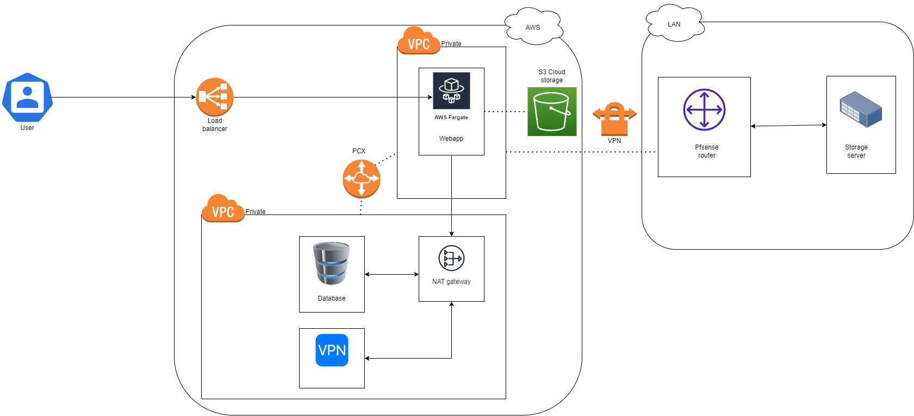
Our network

Slide 11

Demo
VPN
WEBAPP

Slide 12

StruggleS
Confusion with VPN connection
Dockerizing webapp
Hosting dockerized webapp / fargate
Development of the webapp
Notes:
- Searching for right templates like apache, ubuntu, python and making it work with nginx
- Problems docker network fargate
- Problems with sqlalchemy database and sound with converter

Slide 13
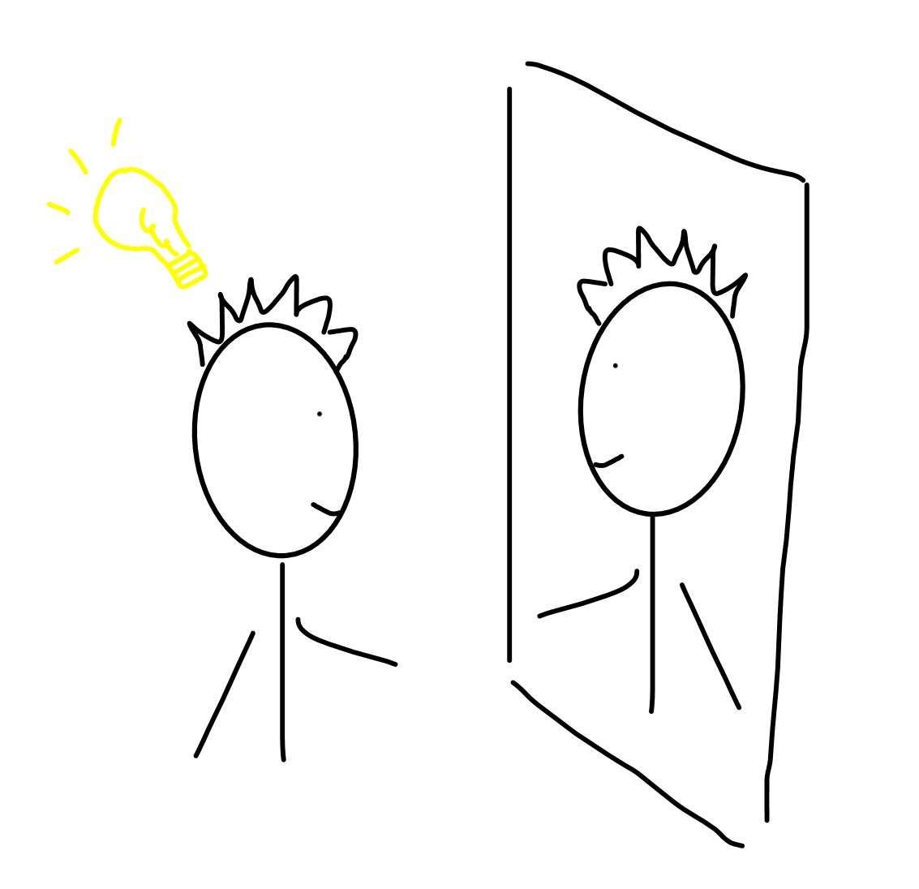
Reflection
Jorn:
Lots of struggles
Succeded in most
I think we are on the right track
Soufiane:
confusing
Still managed
Mihai
New GUI difficulties
Different implementation planning (EC2)

Slide 14

Whats next?
Finishing the web app
Adding a storage server in infralab
Automating with ansible/terraform

Slide 15

Thank You

